Slide 1
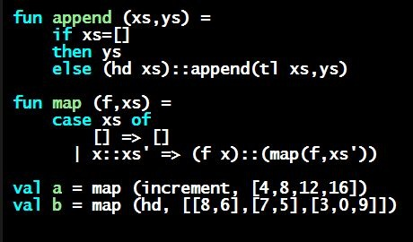
Programming Languages Dan Grossman University of Washington
Grading Policy

Slide 2
Grading Policy
Everything in this video also detailed elsewhere
So video is optional, but helps highlight key points
Hope grades are not our focus, but clarity still valuable
Key issues:
What the policies are
Why [optional]

Slide 3
Auto-Grader Policy
Homework grading stricter than in most MOOCs
Auto-grading score must exceed 80% [may change?]
Encouraged to continue past that!
Can resubmit at most once per day
Apologies in advance for “wrong-file”, “tiny issue”, etc.
But really want you to be confident and do-the-whole-thing
Stricter policies in the past:
On campus: Turn it in once
Older MOOC offerings: At most two non-zero submissions

Slide 4
More rationale
Thinking rather than random twiddling: learn more, save time
(Definitely advantages and disadvantages here)
Auto-grader feedback without making 100% trivial
There is no perfect policy, only trade-offs
Motivation and strictness here more like “real courses” and less like “the Internet”

Slide 5
Challenge Problems
Worth a very small amount: great opportunity, but not intended to affect grade much
Unfortunately, currently can’t give > 100% on an assignment
Will fix if Coursera platform allows
[So video may be outdated?]

Slide 6
Peer assessment
Cannot do until passing the auto-grader
Why: Rubric requires sample solution
Coursera-platform issue currently:
We can “lock” a reading with the sample solution and rubric
You should not “do peer assessment” until the reading is unlocked
Need to upload your file again for peer assessment
Actual grade on peer assessment won’t affect passing, but still required
Worth 10% of each homework grade, no minimum provided you do it

Slide 7
Peer assessment: why?
Style matters!
And you will learn a lot by assessing and being assessed
And reviewing other solutions, including sample
More than I expected before creating the MOOC
Be kind and helpful
Should not be time-consuming

Slide 8
Exam(s)
Like auto-graders for assignments:
At least 80%
At most once per day
Worth same amount as a homework
Honor system: At most 90 minutes
Open book/note/computer, closed Internet-search
Time limit so you study first, not look up answers as you go
You will get much more out of the course if you study in advance!
Practice exam is different but a good guide

